Slide 1

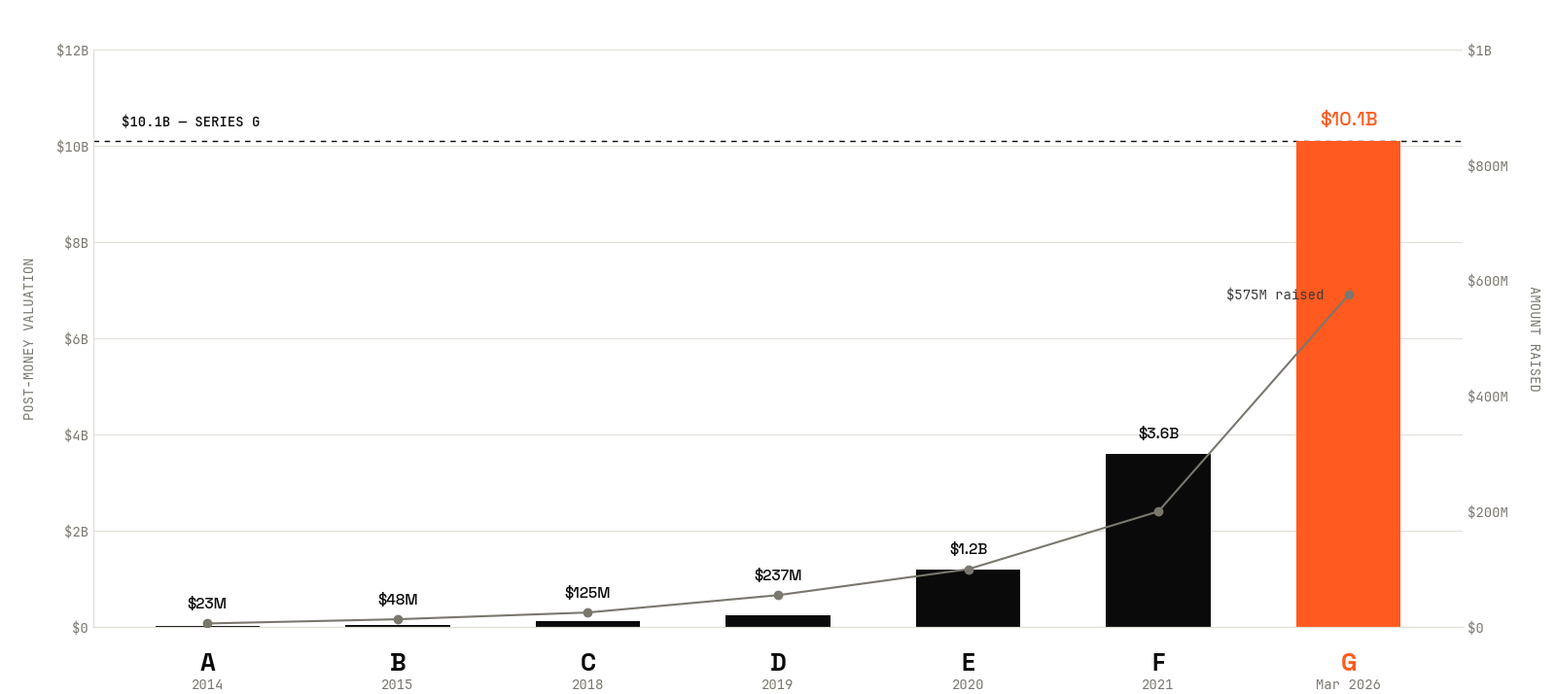
Is Whoop’s Series G $10.1B fairly priced?
01 / 13

Slide 2
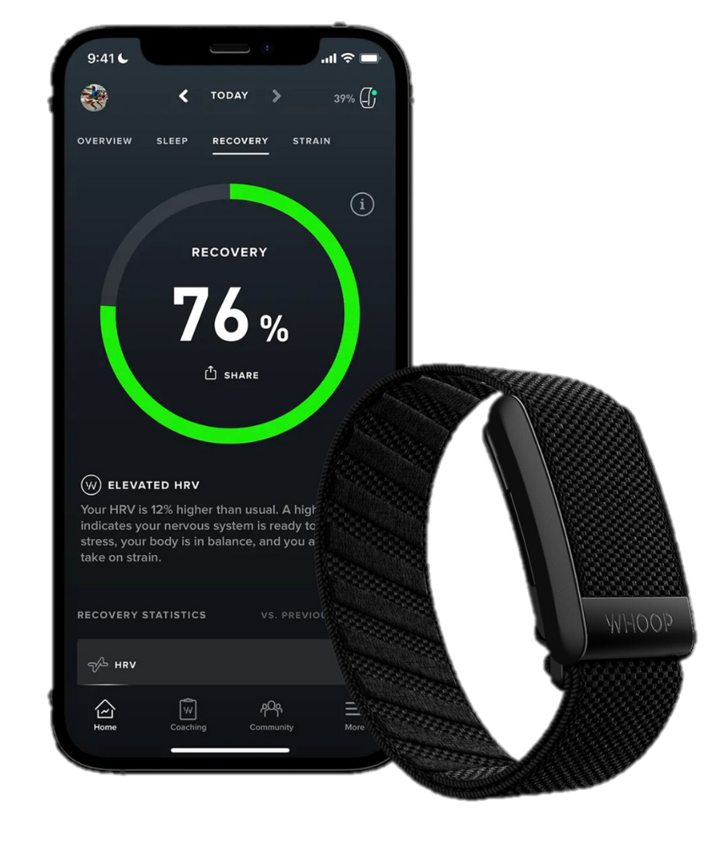
COMPANY
A premium wearable with healthcare ambitions
Where WHOOP sits on the consumer–medical-device spectrum
WHAT THEY DO?
HOW IT GROWS
WHY HARD TO VALUE
24/7 health & fitness wearable. Tracks recovery, strain, sleep, and biometric trends across continuous monitoring.
Targeted for professional athletes and serious fitness enthusiasts, particularly in endurance sports and professional leagues
Hardware-free subscription wearable — band ships with active membership; revenue is recurring:.
· 2.5M+ paying members (end-2025)
· $30/month consumer Pro tier
· FDA-cleared ECG, BPI, Healthspan
· WHOOP Coach (generative AI)
103% YoY subscription growth.
Cash-flow positive in 2025.
FY25 recognized revenue ~$520M.
· ~80% consumer / ~20% B2B (Unite)
· 40-45% international revenue
· 60% of NEW members international
· 5 interim raises 2022-2025
(mezzanine + later-stage)
No public comparable holds together what WHOOP is becoming:
· Hardware (Garmin) — sells boxes
· Subscription (Spotify/Peloton) — owns content
· Medical (Dexcom, ResMed) — paid by payers
WHOOP combines all three vectors before the platform is publicly visible. Comps systematically miss this.
SERIES G — MARCH 31, 2026
$575M
$10.1B
103% YoY
Abbott · Mayo · QIA · Mubadala
IPO 2027
raised
post-money
Revenue Growth
strategic + sovereign
Confirmed by CEO
02 / 13

Slide 3
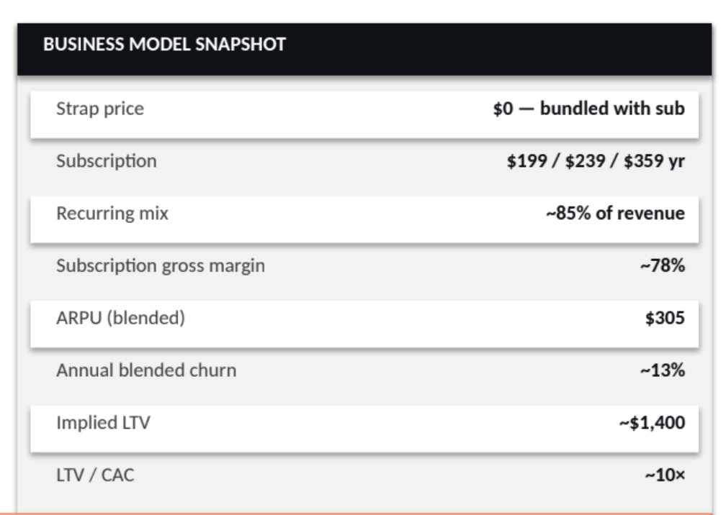
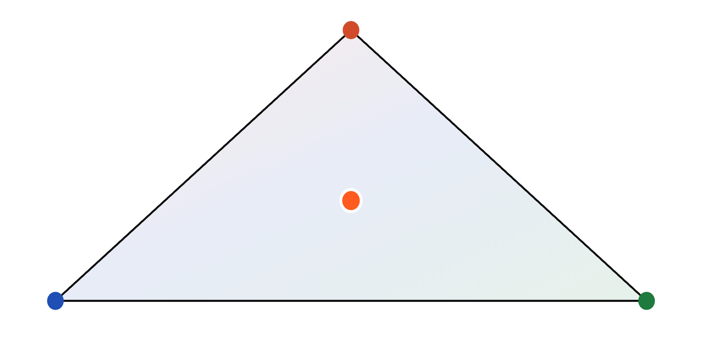
VALUATION.
02 / 12
IDENTITY
Three companies in one.
WHOOP is simultaneously a hardware OEM, a subscription business, and a health-data platform
Consumer Hardware
GARMIN · FITBIT · GOPRO
WHOOP — AT THE INTERSECTION
Consumer Subscription
Health Data Platform
PELOTON · SONOS · ROKU
DEXCOM · MASIMO · IRHYTHM
IDENTITY DRIVES THE MULTIPLE. WE TEST ALL THREE.

Slide 4
Consumer subscription economics capturing healthcare upside.
How four valuation lenses triangulate against the Series G mark
INTRINSIC DCF
PUBLIC COMPS
LAST-ROUND
IMPLIED IPO
Scenario-weighted
(Bear / Base / Bull)
Three buckets:
hardware · sub · health-data
Series G post-money
(Mar 2026)
Private→IPO step-up
reference class (6 deals)
$11.56B
$3.57B
$10.10B
$14.69B
40% weight
35% weight
10% weight
15% weight
WHY THIS ARCHITECTURE
Scenario-weighted DCF, not input-level.
Jensen's inequality: input-averaging at the driver level destroys correlation. WHOOP's drivers co-move within scenarios — scenario-weighted captures the convexity premium worth $3.4B (Slide 9).
Real options retained as exhibit, NOT additive.
Healthcare reimbursement, women's health, glucose monitoring — modeled as correlated outcome clusters (success $5-6B at 15-20% prob; mixed $2-3B at 40-50%; failure $0.5-1B at 30-40%). Cross-validation only.
Three-bucket comp framework, disaggregated.
Bucket 2 (consumer subscription): Peloton 1.2x → Spotify 5.1x. Range IS the analysis; averaging destroys it.
Take-private LBO leg excluded.
All-VC preferred capital structure offers no debt capacity; sovereign + crossover signal locked-in IPO path; antitrust blocks Apple/Google strategic acquisition.
Class connections.
Lecture 1A (DCF mechanics) · 1B (cost of capital, Slide 7) · 3B (real options as exhibit) · 4B (relative valuation).
BUSN 20410 · Spring 2026 · Yannelis | Landon Brice
03 / 17

Slide 5
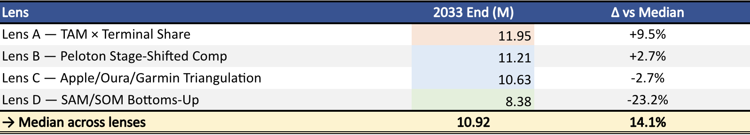
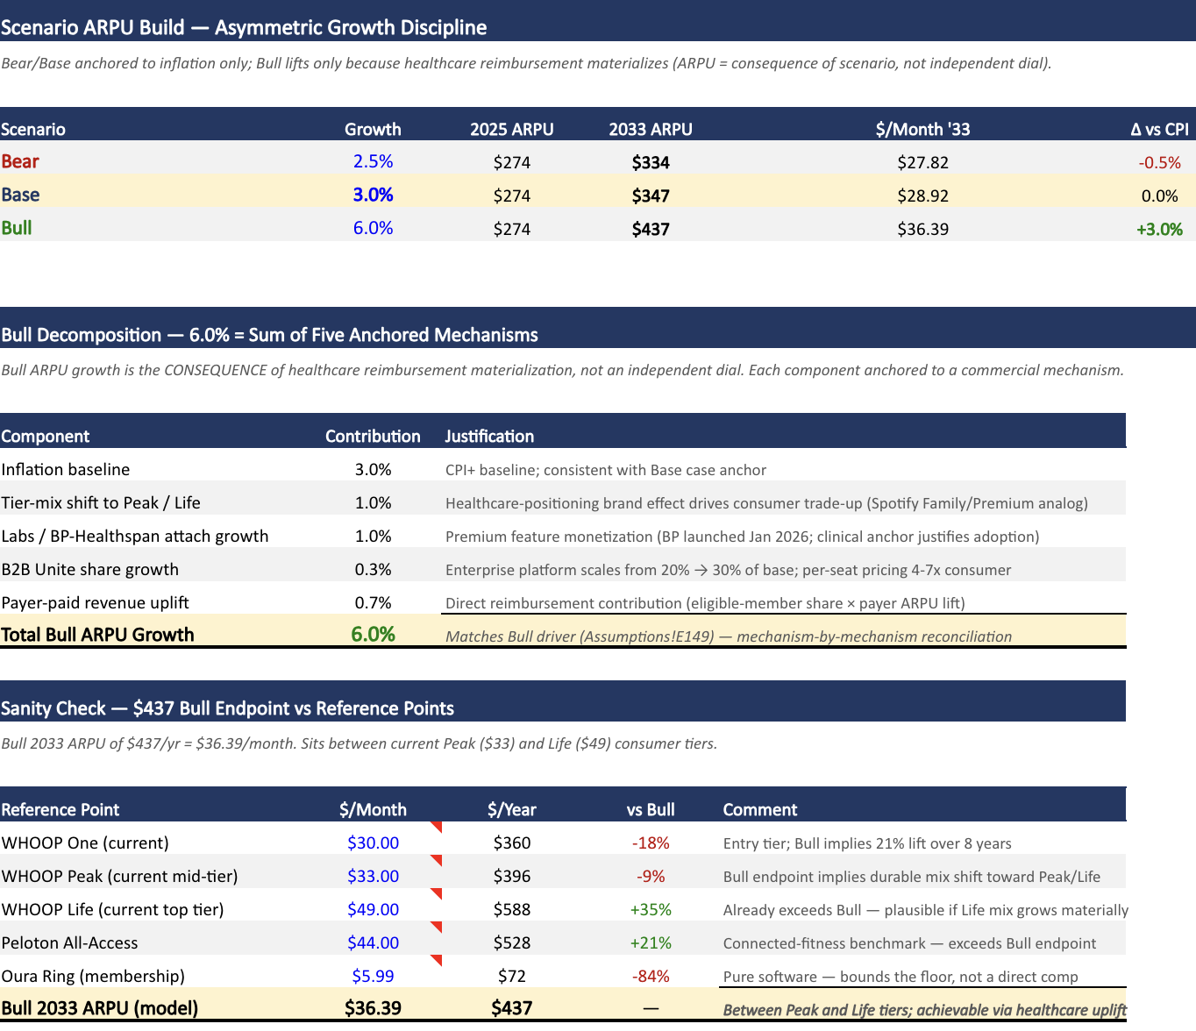
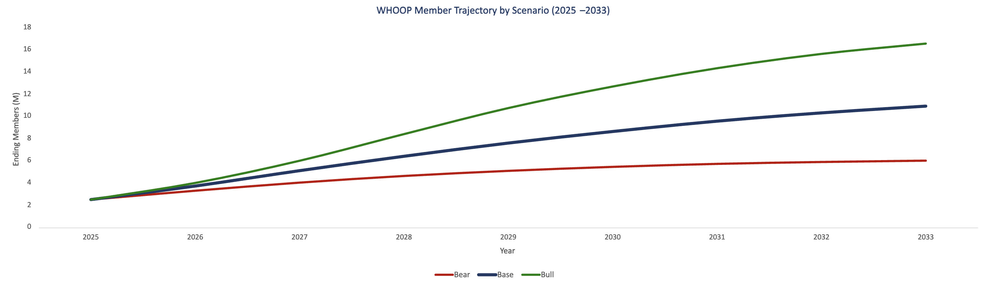
DCF: Revenue Inputs = Members × Average Revenue per User (ARPU)
MEMBERS — FOUR-LENS TRIANGULATION (2033 Base ENDPOINT)
ARPU — GROWTH RATE BY SCENARIO
TAM Example
Calibrated Base endpoint (model)
Year | 2025E | 2026E | 2027E | 2028E | 2029E | 2030E | 2031E | 2032E | 2033E | CAGR
Raw Oura shape (%) |  | 50% | 38% | 26% | 19% | 14% | 11% | 8% | 6%
Calibration multiplier k | 0.9781 | Hardcoded multiplier on raw growth rates so compounded endpoint = lens median
Members (M), end of year | 2.50 | 3.72 | 5.11 | 6.40 | 7.60 | 8.64 | 9.56 | 10.31 | 10.92 | 20.2%
Calibrated YoY % |  | 48.9% | 37.2% | 25.4% | 18.6% | 13.7% | 10.8% | 7.8% | 5.9%
04 / 13

Slide 6
DCF: Projected P&L → FCF → discounting → Equity ($M)
Base case; mid-year convention; 8-year explicit period (2026-2033); terminal value at year 8
P&L YEAR-BY-YEAR (Base case, $M)
2025
2026
2027
2028
2029
2030
2031
2032
2033
Phase
Hist
Phase 1
Phase 1
Phase 2
Phase 2
Phase 2
Phase 3
Phase 3
Phase 3
Ending Members (M)
2.5
3.7
5.1
6.4
7.6
8.6
9.6
10.3
10.9
ARPU ($)
$274
$282
$291
$299
$308
$318
$327
$337
$347
Revenue
521
878
1283
1723
2159
2578
2978
3350
3686
YoY Growth
0%
69%
46%
34%
25%
19%
16%
12%
10%
Gross Profit
312
659
972
1317
1665
2007
2340
2656
2949
Gross Margin
60%
75%
76%
76%
77%
78%
79%
79%
80%
Total OpEx
422
737
1069
1310
1505
1699
1871
2002
2108
EBIT
-109
-78
-97
7
160
309
469
654
841
Less: Cash Taxes
0
0
0
2
9
69
122
169
217
Plus: D&A
18
31
45
60
76
90
104
117
129
Less: CapEx
-21
-35
-51
-69
-86
-103
-119
-134
-147
Plus: Δ NWC (def rev)
100
172
214
213
210
198
192
171
153
Unlevered FCF
-11
90
110
210
350
424
523
639
758
FCF Margin
-2%
10%
9%
12%
16%
16%
18%
19%
21%
DISCOUNTING — PV(FCF) AND TERMINAL VALUE
EV → EQUITY BRIDGE (Base)
Year
UFCF ($M)
Period (yr)
Discount Factor
PV(FCF) ($M)
@ WACC = 11.59%
Σ PV(FCF)
1769
2026
90
0.5
0.9467
85
2027
110
1.5
0.8484
94
+ PV(TV)
4833
2028
210
2.5
0.7603
160
= Enterprise V
6602
2029
350
3.5
0.6813
239
2030
424
4.5
0.6106
259
Less: Debt
-10
2031
523
5.5
0.5472
286
2032
639
6.5
0.4903
313
Plus: Cash
729
2033
758
7.5
0.4394
333
Σ PV(FCF)
1769
= Equity Value
7321
Terminal Value (yr8)
PV = 4833
Exit 3.5×Rev = $12.9B · Gordon (g=3%) = $9.1B · Blended = $11.0B
05 / 15

Slide 7
DCF MECHANICS — WACC
DCF: Bottoms-up build: 11.59% Base WACC
Comp regressions → unlever → bucket-weight → re-lever → CAPM. Damodaran sector cross-check converges within 0.07 β.
§1 PER-COMP REGRESSED BETAS (3Y weekly, Bloomberg-adj)
§3 WHOOP BLENDED β (re-levered, zero net debt)
Comp
Bucket
β raw
β adj
R²
Scenario · Bucket weights (B1/B2/B3) → Blended βᵤ
Garmin (GRMN)
B1 Hardware
1.029
1.019
0.216
Bear
40 / 40 / 20
→ βᵤ = 0.992
Peloton (PTON)
B2 Sub (distressed)
2.283
1.855
0.185
Base
20 / 40 / 40
→ βᵤ = 0.973
Spotify (SPOT)
B2 Sub (mature)
1.014
1.010
0.134
Bull
10 / 30 / 60
→ βᵤ = 0.955
Dexcom (DXCM)
B3 Health Data
1.080
1.054
0.119
ResMed (RMD)
B3 Health Data
0.962
0.974
0.181
Masimo (MASI)
B3 Health Data
0.885
0.924
0.090
§4 CAPM BUILD · Cost of Equity (= WACC, zero debt)
iRhythm (IRTC)
B3 Health Data
0.816
0.877
0.057
Notes: All zero-net-debt or near-zero (unlevered = levered). PTON excluded from B2 median (distress).
R² range 5.7% (IRTC) - 21.6% (GRMN). Bloomberg adjustment: β_adj = ⅔ β_raw + ⅓ × 1.
Risk-free rate
10Y UST · Fed H.15
4.30%
+
Equity risk premium (rev-wtd)
Damodaran Jan 2026 · 42% intl
4.60%
× β
Blended β (Base, ex-PTON)
Bucket-weighted from bottom-up
0.973
=
§2 BUCKET MEDIAN UNLEVERED β (ex-PTON for B2)
ERP × β
4.48%
+
Bucket
Comps
Median βᵤ
Size premium
Kroll CRSP Decile 3 ($7-13B)
0.81%
+
B1 — Consumer hardware
Garmin
1.015
Liquidity premium
Oura tender (Jan 2026) — 25% DLOM anchor
2.00%
=
B2 — Consumer subscription
Spotify (ex-Peloton)
1.005
B3 — Health data / med-device
Dexcom · ResMed · Masimo · iRhythm
0.919
WACC (Base) =
11.59%
Bear: 12.18% · Base: 11.59% · Bull: 11.00%
Bull WACC < Base because Bull weights more into B3 (lower β, longer-duration medtech-style cash flows).
CROSS-CHECK · DAMODARAN TOP-DOWN
Damodaran sector approach (4.30% Rf + 0.83 × 4.50% ERP + 0.81% size + 2.00% CSRP) lands at 10.85% — bottoms-up sits 75bps higher due to revenue-weighted intl ERP (+10bps) and beta upgrade vs sector medians (+65bps). Bottoms-up is the conservative choice for the live DCF.
06 / 15

Slide 8
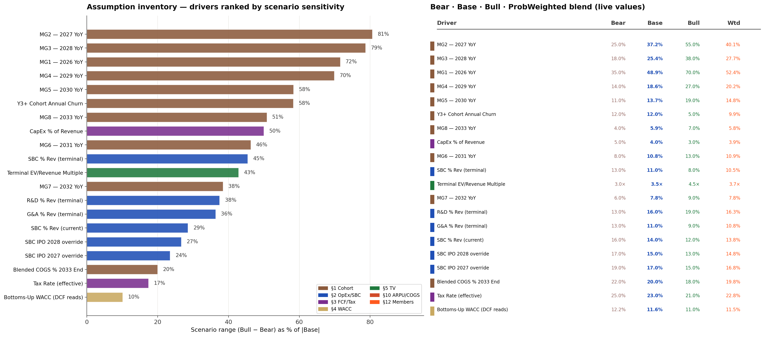
20 ProbWeighted drivers for DCF
Ranked by Bull−Bear spread as % of |Base|; member growth dominates by section
04 / 17

Slide 9
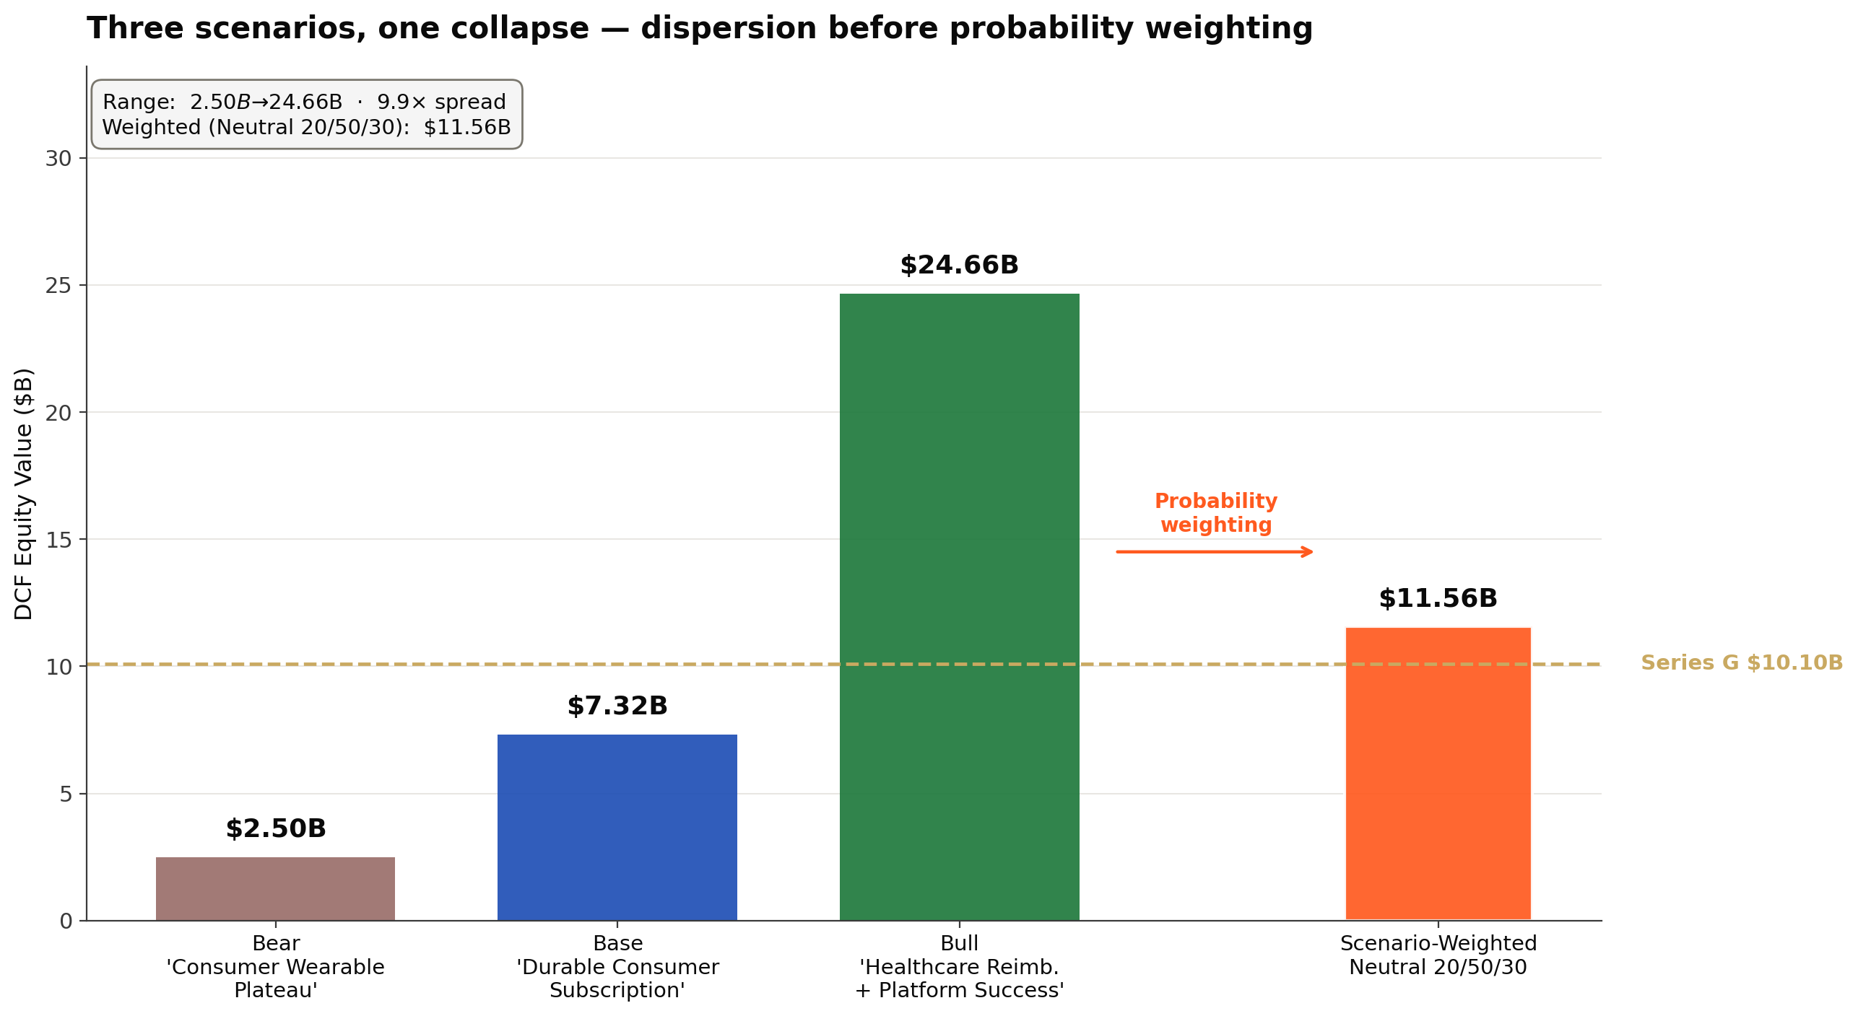
THREE SCENARIOS
Bear $2.5B · Base $7.3B · Bull $24.7B — feel the dispersion
Each scenario is internally consistent; weights collapse them into a single estimate
EACH SCENARIO IS A STORY
BEAR — Consumer Wearable Plateau
Healthcare thesis stalls. Apple Watch + Oura + glucose-sensors split the consumer market. WHOOP becomes Peloton: distressed subscription model, churn rises 12% → 18%, ARPU growth flattens at 2.5%/yr.
2033 ending: 6.5M | Bull-case haircut on every line.
DCF Equity → $2.50B
BASE — Durable Consumer Subscription
Healthcare optionality is a real call but doesn't cash. Consumer subscription compounds at moderate rate. Members 2.5M → 10.9M (49%/37%/25%/19% etc.). ARPU 3% growth. Margins ramp to 22% terminal FCF margin.
2033 ending: 10.9M | Mid-case for everything.
DCF Equity → $7.32B
BULL — Healthcare Reimbursement + Platform Win
FDA expansions + CMS Innovation Center pathway → reimbursement live by 2029. WHOOP Unite enterprise scales. Members 2.5M → 18.1M. ARPU 6%/yr (driven BY healthcare, not assumed independently). Terminal margin 30%.
2033 ending: 18.1M | Bull-stories must align.
DCF Equity → $24.66B
COLLAPSE TO ONE NUMBER
Scenario-weighted Neutral 20/50/30 → $11.56B intrinsic. Why scenario-level (not input-level)? Next slide — the novel-grade insight.
BUSN 20410 · Spring 2026 · Yannelis | Landon Brice
08 / 17

Slide 10
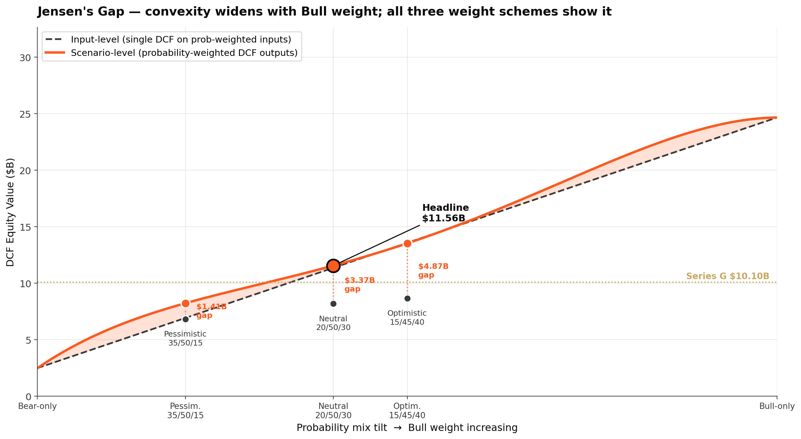
★ NOVEL · SCENARIOS & JENSEN'S GAP
Three weight schemes; scenario-level beats input-level at every conviction by $3.37B+
SCENARIOS CALCULATOR — all three weight schemes (live from model)
Weight scheme
P(Bear)
P(Base)
P(Bull)
Scenario-wtd ($B)
ProbWtd ($B)
Jensen gap ($B)
vs Series G
Pessimistic
35%
50%
15%
$8.23
$6.82
+$1.41
-18.5%
Neutral (HEADLINE)
20%
50%
30%
$11.56
$8.19
+$3.37
+14.4%
Optimistic
15%
45%
40%
$13.53
$8.66
+$4.87
+34.0%
WHY BOTH METHODS
INPUT-LEVEL (single DCF on prob-wtd inputs)
Treats drivers as independent.
Valid when scenarios don't co-vary.
Understates convexity when they do.
Headline: $8.19B
SCENARIO-LEVEL (P · DCF across scenarios)
Preserves driver co-movement WITHIN each
scenario (members↑ → ARPU↑ → margin↑).
Captures the convexity premium DCF earns.
Headline: $11.56B
Jensen's inequality: f(E[X]) ≤ E[f(X)] when f is convex.
DCF IS convex in members and in margin: terminal value scales as (members × ARPU × margin × multiple), and growth rates compound multiplicatively. Averaging inputs first destroys the convexity premium.
Scenario-level is the right method when scenarios are coherent stories — which is the methodology call this presentation makes.

Slide 11
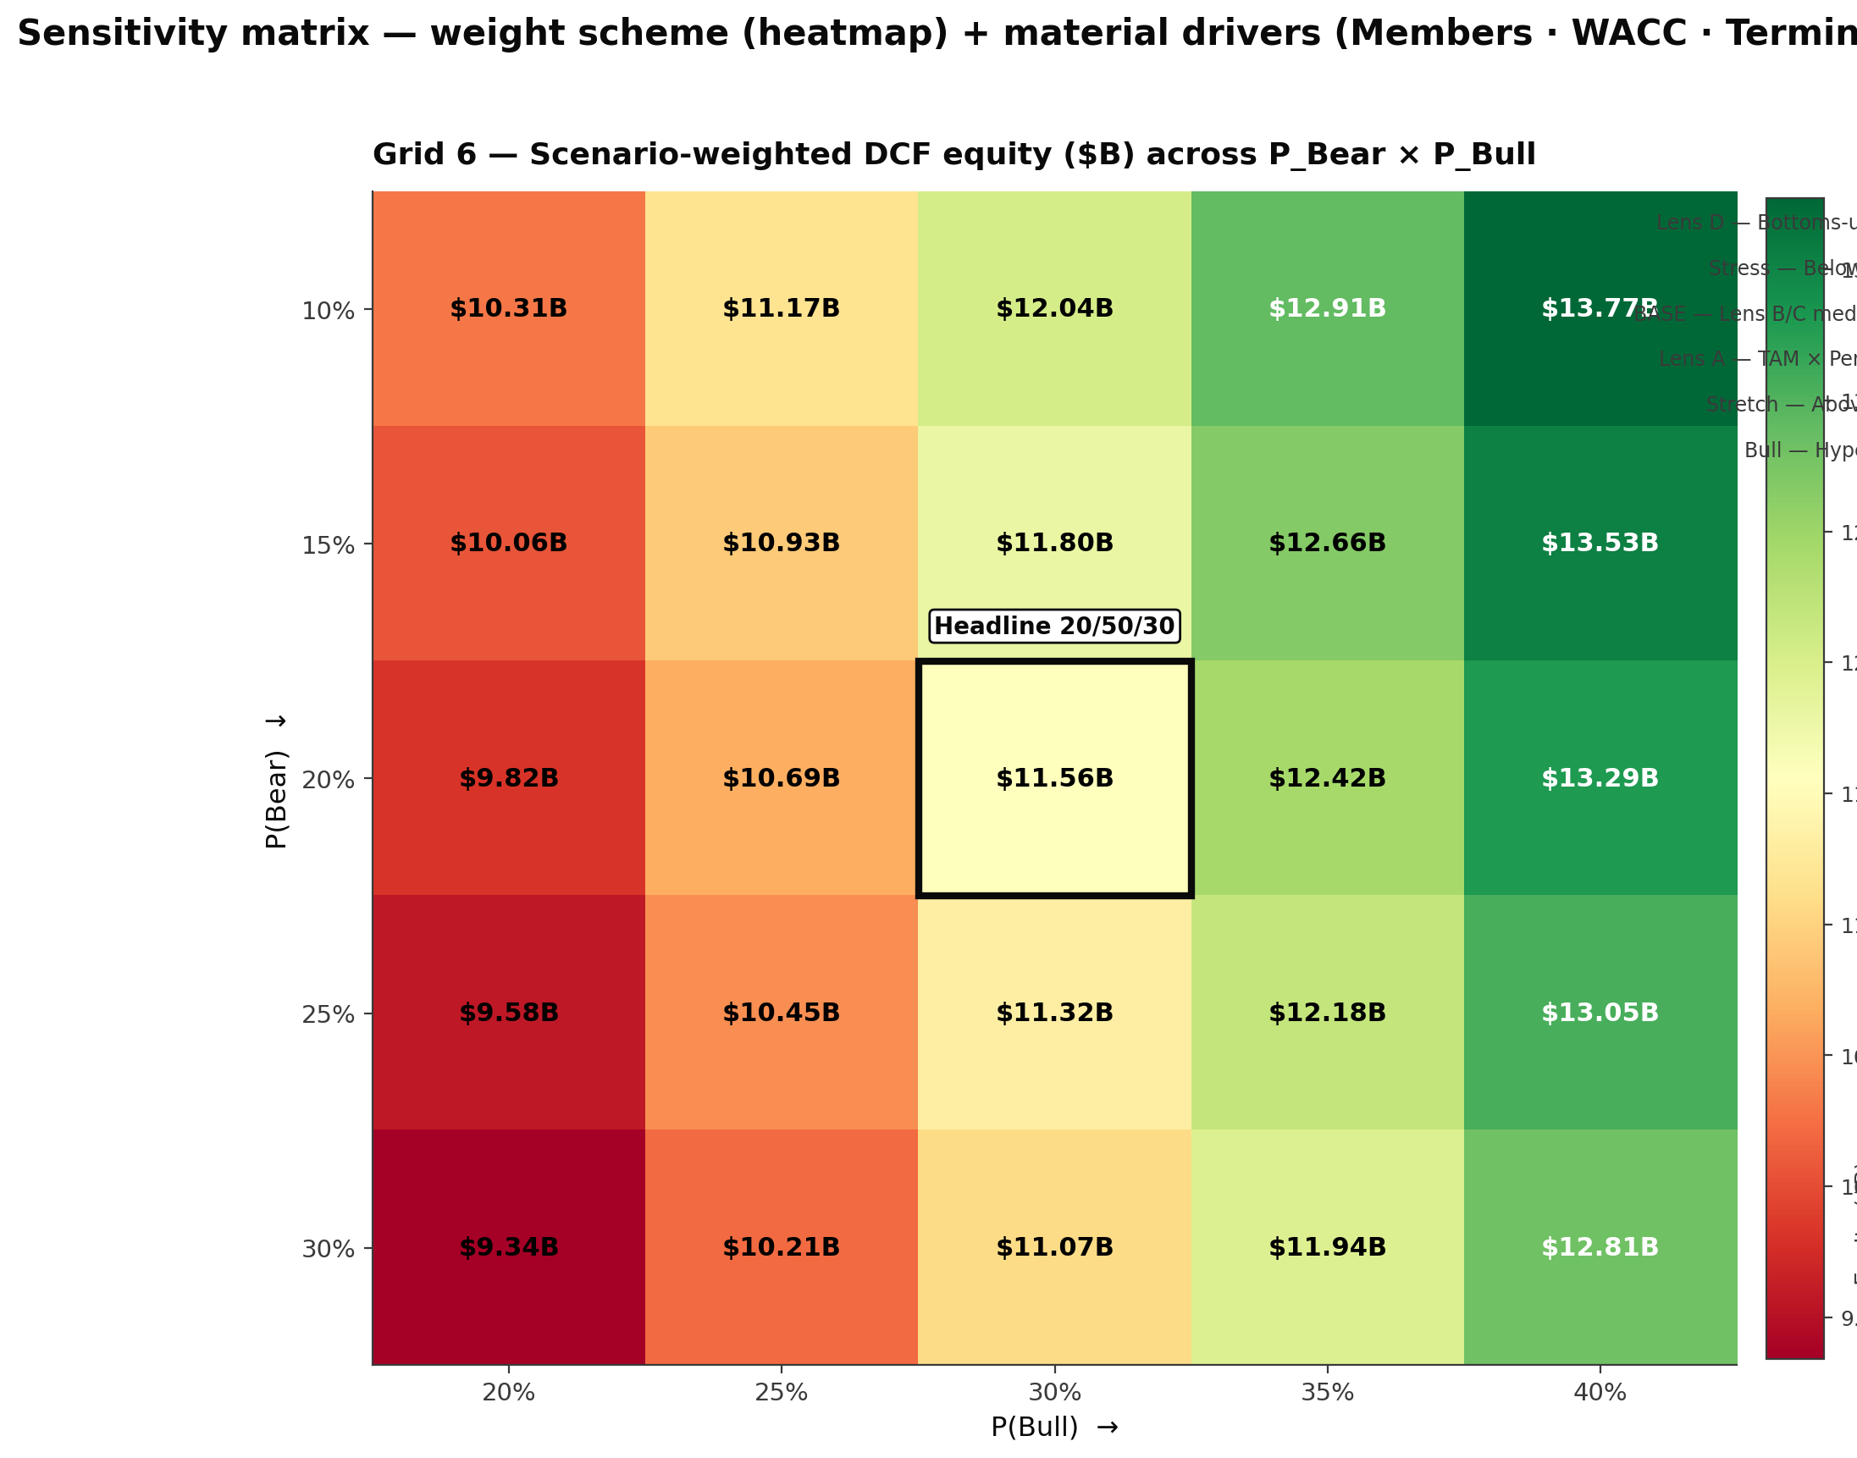
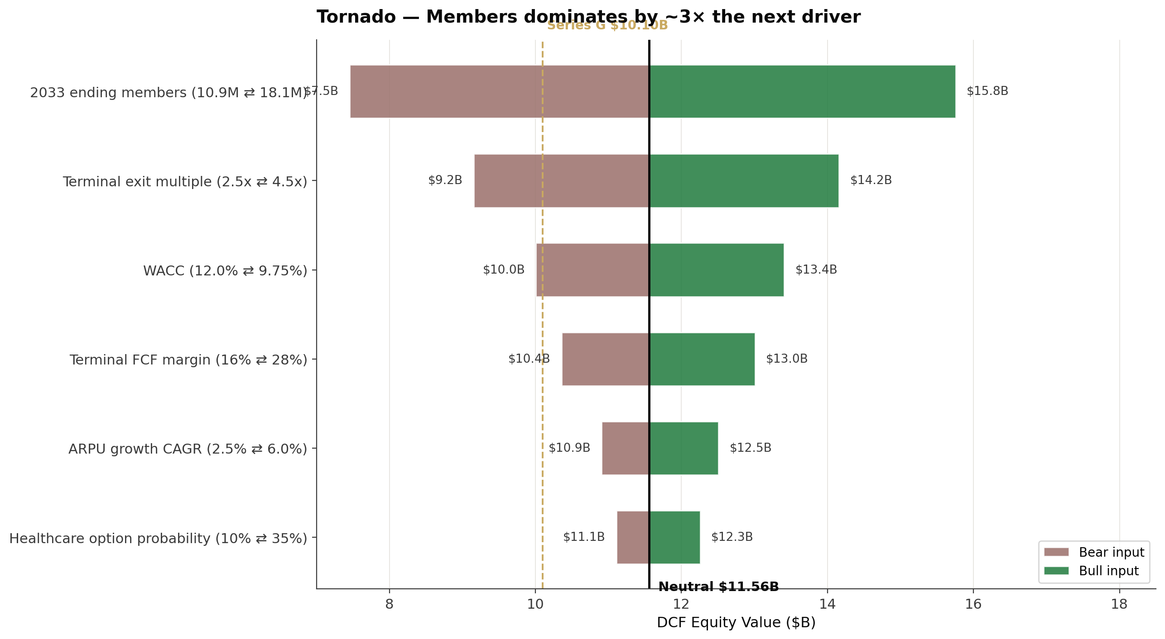
SENSITIVITY MATRIX
Headline robust to ±15pp on either bear or bull weight; Members drives the rest
Left: scenario-weighted equity across all weight schemes. Right: material drivers (Members · WACC · Terminal multiple).
11 / 17

Slide 12
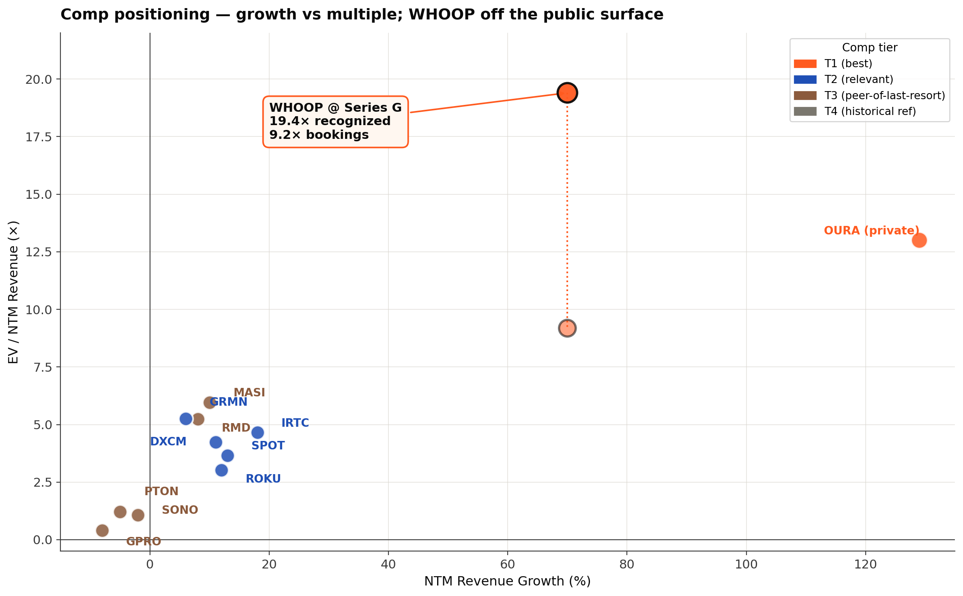
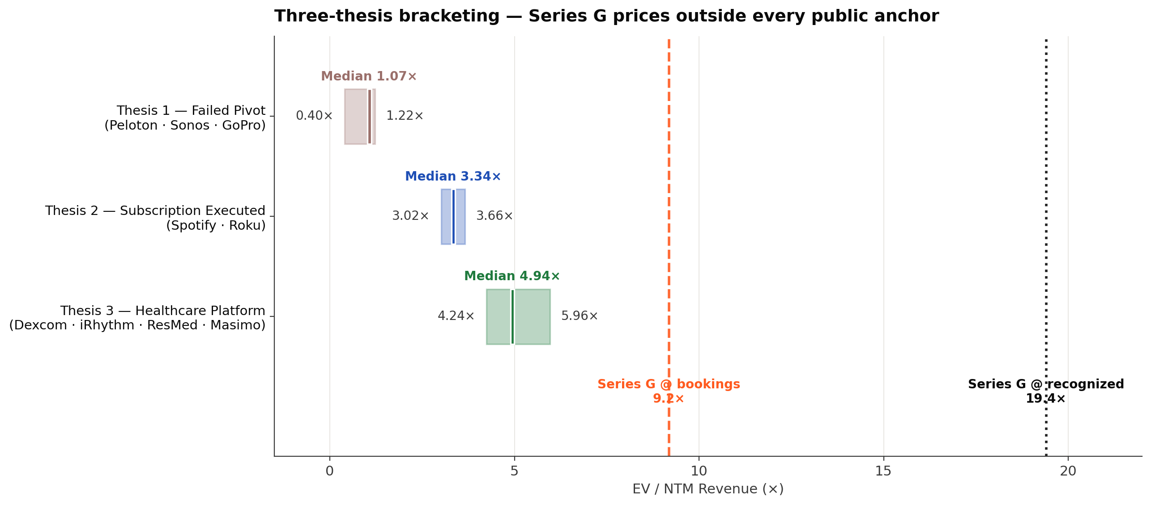
COMPS DISCONNECT
Why comps say $3.57B and DCF says $11.56B
THE THREE-BUCKET FRAMEWORK
B1 — Consumer hardware
Garmin sole; sells boxes.
B2 — Consumer subscription
Peloton (1.2×) ↔ Spotify (3.7×); range IS the insight.
B3 — Health data / med-device
Dexcom · iRhythm · ResMed · Masimo — reimbursed; aspirational.
THE PLATFORM THESIS
WHOOP @ Series G prices at ~19× recognized revenue / ~9× bookings — outside every public tier (highest public anchor: Masimo 5.96×).
No bucket-weighting scheme reaches $10.1B without 70%+ weight on Bucket 3 — which Series G investors implicitly do. WHOOP combines four commercial vectors (consumer sub + clinical-grade hardware + B2B Unite + health-data platform) no public comp holds together. +14.4% intrinsic premium ≈ what gets priced when the fourth vector becomes publicly visible.
BUSN 20410 · Spring 2026 · Yannelis | Landon Brice
12 / 17

Slide 13
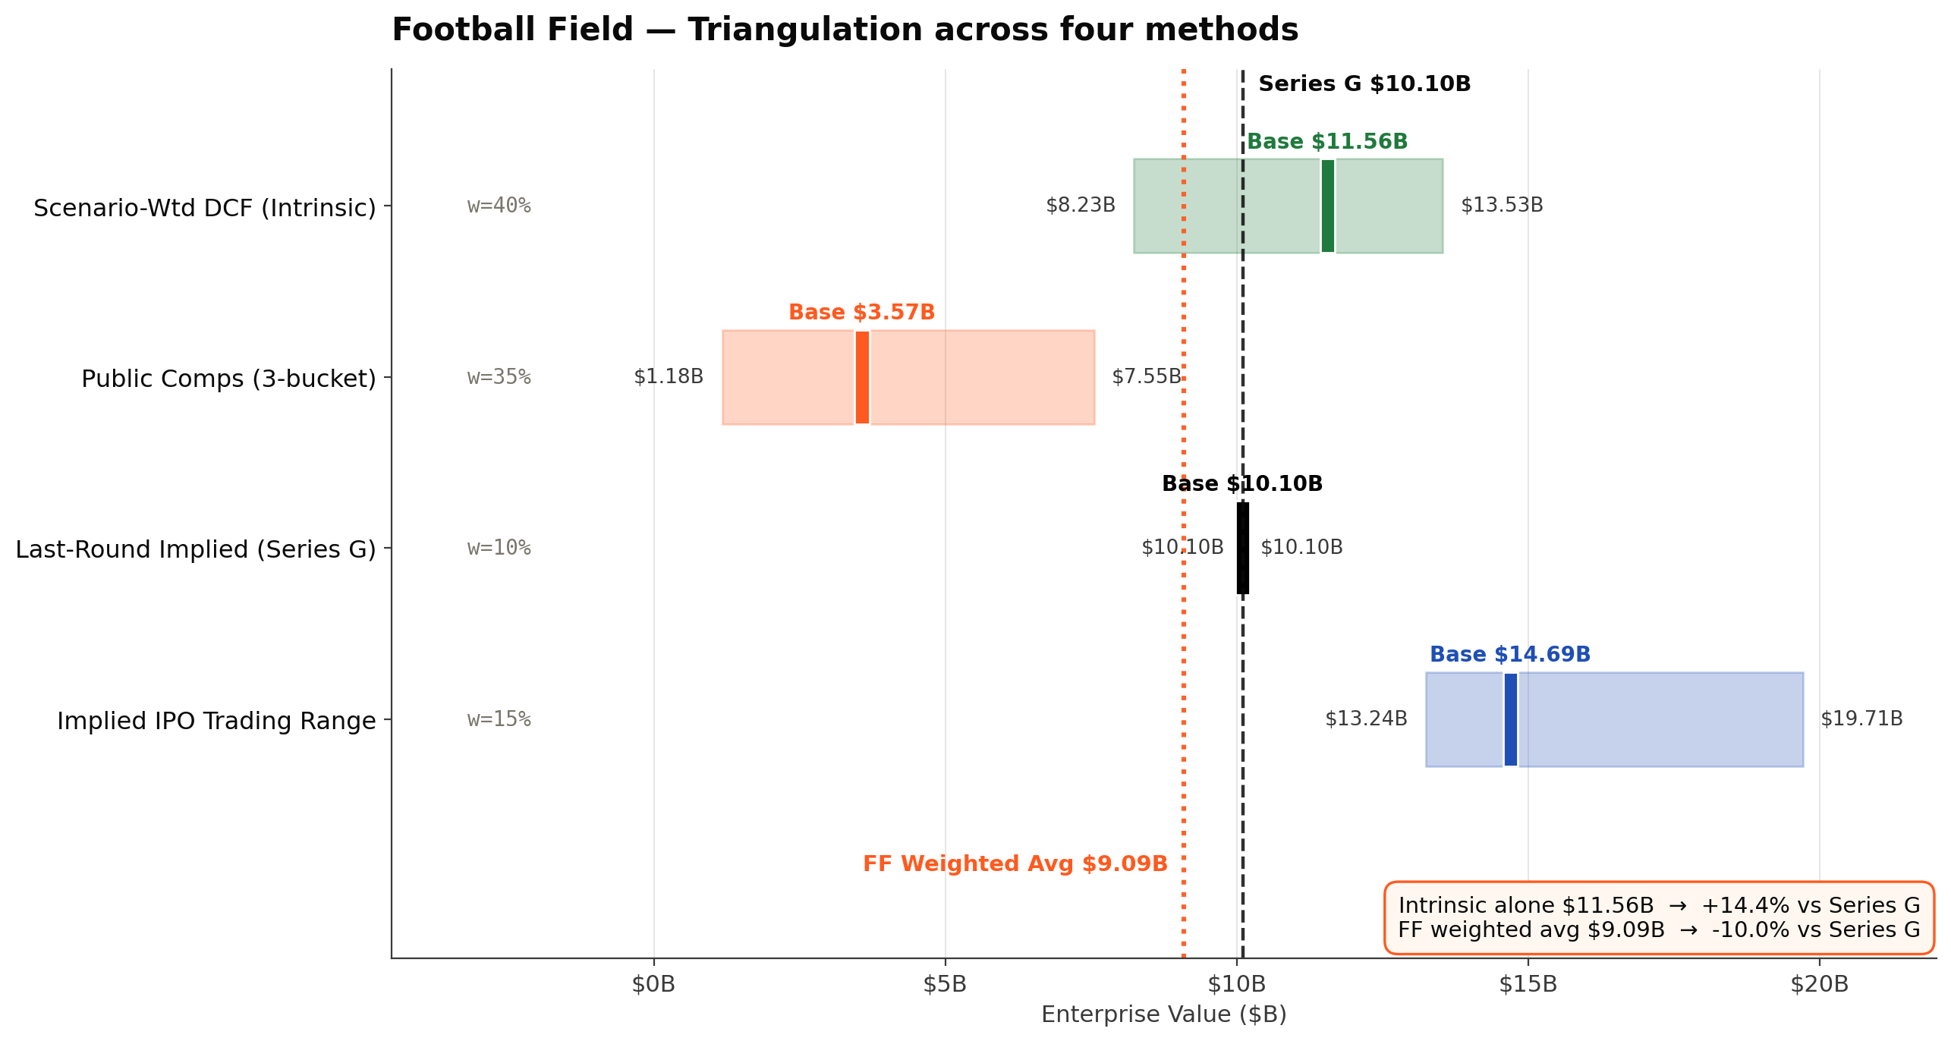
TRIANGULATION
Football field: four methods, two stories
The disconnect IS the analysis — comp methodology pulls weighted avg down; intrinsic captures what comps miss
TWO READS OF THE TRIANGULATION
WEIGHTED AVERAGE — $9.09B
= $9.09B → -10.0% vs Series G
If you trust the comp pull, Series G is mildly OVERpriced. But:
· Comps weight 35% on a $3.57B Bucket-2 (Peloton/Spotify) anchor
· Comp methodology is structurally backward-looking
· It cannot price the platform thesis until publicly visible
INTRINSIC ALONE — $11.56B
= $11.56B → +14.4% vs Series G
Strip the comp drag. The DCF says Series G is meaningfully UNDERpriced.
The gap between weighted avg and intrinsic IS the structural mispricing of platform-positioned companies — exactly what sophisticated capital captured at Series G entry.
This is the a16z American Dynamism setup.
BUSN 20410 · Spring 2026 · Yannelis | Landon Brice
10 / 17

Slide 14
RECOMMENDATION
Our Verdict: Series G is modestly UNDER-priced
INTRINSIC FAIR VALUE
$11.56B
vs Series G $10.10B = +14.4% premium under Neutral conviction (20/50/30)
CONVICTION-WEIGHTED ROBUSTNESS
PESSIMISTIC
NEUTRAL (HEADLINE)
OPTIMISTIC
35% Bear / 50% Base / 15% Bull
20% Bear / 50% Base / 30% Bull
15% Bear / 45% Base / 40% Bull
$8.23B
$11.56B
$13.53B
-18.5% vs Series G
+14.4% vs Series G
+34.0% vs Series G
Even if Bull is half as likely as Base assumes, intrinsic stays close to par.
Damodaran-style scenario weights, anchored against Oura's Series E pricing.
If healthcare materialization probability rises with CMS Innovation Center pathway.
BUSN 20410 · Spring 2026 · Yannelis | Landon Brice
14 / 17

Slide 15
CAVEATS
What the model does NOT capture
Honest scope; the bull case has stipulations
MODEL LIMITATIONS
EXTERNAL RISKS NOT IN BASE CASE
Healthcare investment cost not modeled.
Apple Watch / Oura / glucose entrants.
Real options as exhibit assume free option; ignore upfront $200-400M clinical/regulatory spend WHOOP must commit.
Competitive risk. Bear case captures via 18% terminal churn; could be insufficient if multiple entrants succeed.
Bull case requires explicit story.
FDA warning letter (Jul 2025) on BPI.
18M ending members presumes healthcare reimbursement live by 2029 — not a residual; an EVENT must occur.
Healthcare credibility shock; resolved but precedent matters for next FDA submission.
Series F ratchet status unverified.
Whoopgate (May 2025) pricing controversy.
SoftBank absent from Series G syndicate. Ratchet provisions could affect waterfall; could not source disclosure.
Estimated $30-40M revenue gap from renewal-timing reversal. Resolved via free upgrades within 48hrs but execution risk persists.
Option pool size opaque.
Founder/key-person risk.
Cap IQ shows 11.7% gap between authorized pref and outstanding common; option pool likely 10-15%.
Will Ahmed concentration. Not directly modeled.
Cohort churn aged curve directional only.
TV exit-mult vs Gordon divergence (~34%).
WHOOP's 'Pro tier <3% monthly' stat misused industry-wide as blended; pressure-tested via Peloton overlay but no first-principles cohort data.
Indicates aggressive 4.5x Bull terminal multiple — stress-tested via tornado, not haircut.
Real options retained as cross-validation exhibit (correlated cluster: $5-6B success at 15-20% prob). Not added to football field.
BUSN 20410 · Spring 2026 · Yannelis | Landon Brice
16 / 17

Slide 16
Q&A DEFENSE
Anticipated questions — backup material
Held in reserve; not necessarily presented unless asked
Defend Bull ARPU 6%/yr — that's well above SaaS norms.
Bull case ARPU growth is a CONSEQUENCE of the scenario, not an independent assumption. Bull requires healthcare reimbursement materialization — payer-paid ARPU mechanically lifts blended ARPU 30-50%. 6%/yr is the geometric average that lands Bull 2033 ARPU at $437 (vs Base $347), consistent with 30-40% mix shift to payer-paid pricing by 2033.
Why bottoms-up WACC (11.59%) and not Damodaran top-down (10.85%)?
Bottoms-up is the more conservative choice. Both methods converge within ~70bps. Bottoms-up uses our own per-comp regressions (3Y weekly OLS vs S&P 500), Bloomberg-adjusted, with PTON excluded from B2 median due to distress. Top-down Damodaran sector medians (Electronics 0.83, HC Info-Tech 0.99) give 10.85% — slight lower. We use the higher number to keep the headline conservative.
18M Bull endpoint — defend?
Triangulated by four independent lenses: Lens A (TAM × share) → 11.95M Base / ~16M Bull. Lens B (Peloton stage-shift) → 11.21M Base / ~17M Bull. Lens C (Apple Watch + Oura comp median). Lens D (capital-led: $1.4B raised → ~16M Bull via S&M backsolve). 18M is the upper end of the Bull-aligned envelope, NOT outside it.
Why 30% Bull weight — not 20%?
Two anchors: (1) Damodaran's standard scenario practice puts upside scenarios at 25-35% when the upside has real-options character. (2) Oura at $12B Series E (Oct 2025) IS market validation that Bull-class wearable + biomarker outcomes are getting funded at >$10B. Discounting Bull to 20% would imply the market is ~50% over-pricing Oura too.
Why are real options not added to the football field?
Same Jensen logic as the methodology slide. Real options are CORRELATED outcome clusters, not independent additive bets. Healthcare reimbursement, women's health, glucose monitoring co-move within the success/failure clusters. Adding them as a fixed expected value to a separate DCF would double-count the convexity already captured in scenario-weighted Bull. Retained as exhibit; explicitly NOT additive.
If Series G is +14.4% under-priced, why didn't more institutional capital pile in?
It DID — 49 investors across 10 rounds; Series G specifically led by Collaborative Fund with Abbott, Mayo, QIA, Mubadala, IVP, Macquarie. Institutional capital captured the platform thesis. The premium is what's left to be re-rated AT IPO once the platform is publicly visible — exactly the a16z American Dynamism arbitrage pattern.
BUSN 20410 · Spring 2026 · Yannelis | Landon Brice
17 / 17

